Slide 1
Q-Learning Based Dynamic Done Trajectory Planning in Uncertain Environments
Subrahmanya Chandra Bhamidipati, Prasad Calyam

Slide 2
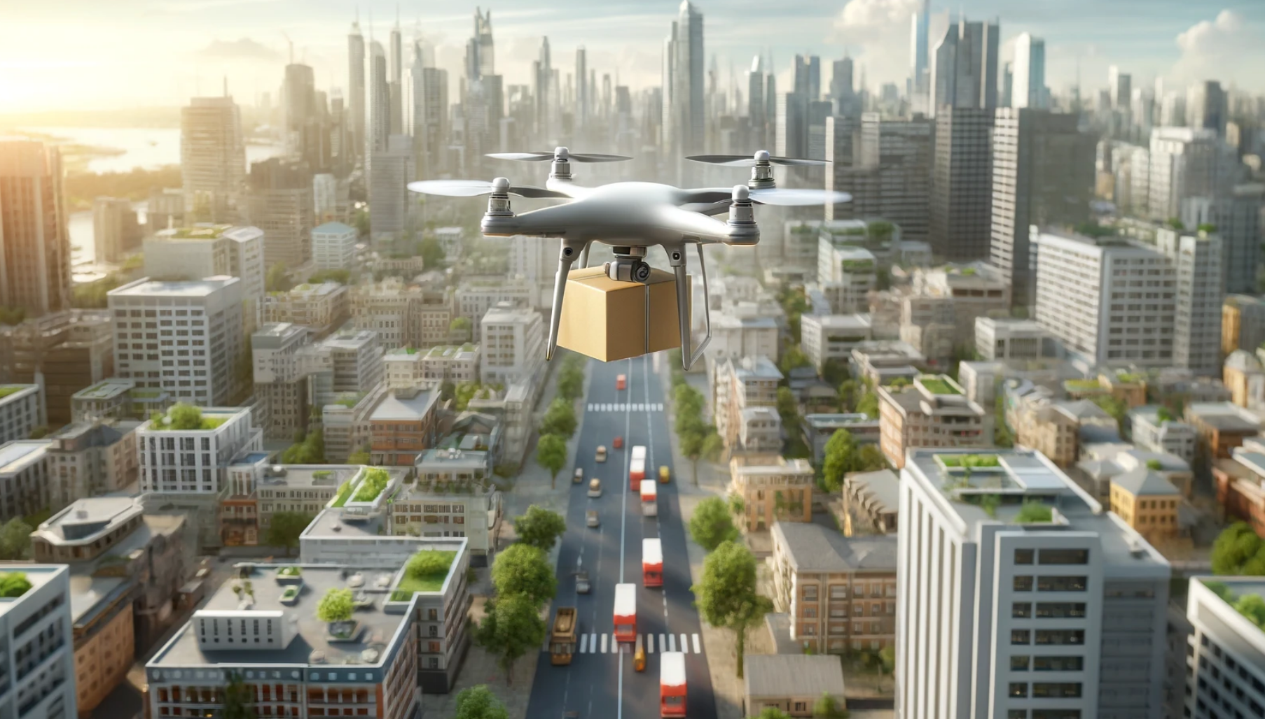
Revolutionizing Last-Mile Delivery
Drones increasingly used in logistics, urban deliveries, disaster relief.
Problem:
Drones face connectivity and navigation challenges in dynamic environments.
Objective:
Introduce Q-learning-based model to enable drones to adapt to network disruptions.
Ensure safety and efficient delivery even without continuous communication with ground control.

Slide 3
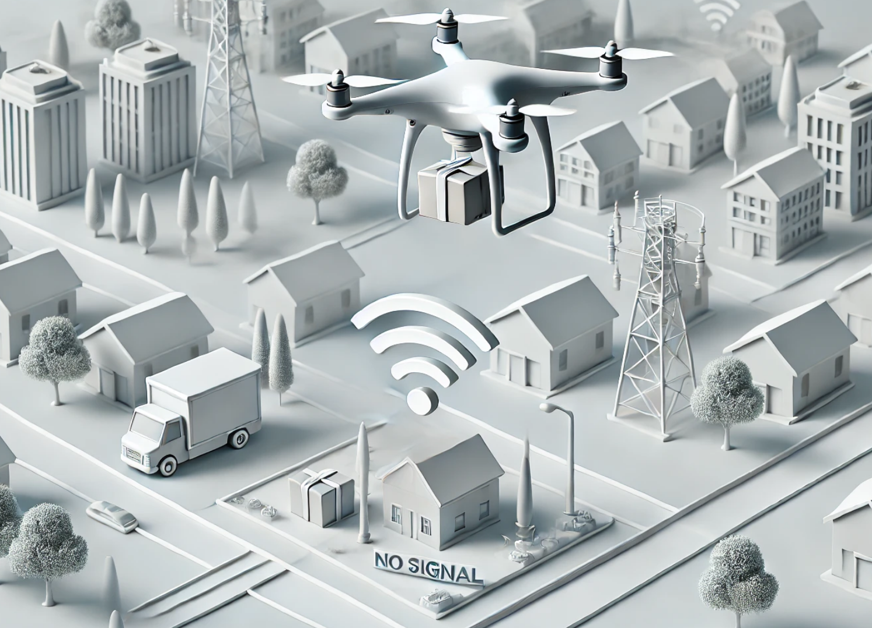

Navigating Challenges
Core Challenges:
Unstable Network Connectivity: Network congestion, obstacles, or distance cause communication loss.
Dynamic Environments: Require drones to navigate around obstacles like buildings, trees, or traffic congestion zones.
Goal: Enable drones to independently make safe, real-time decisions during network disruptions.

Slide 4
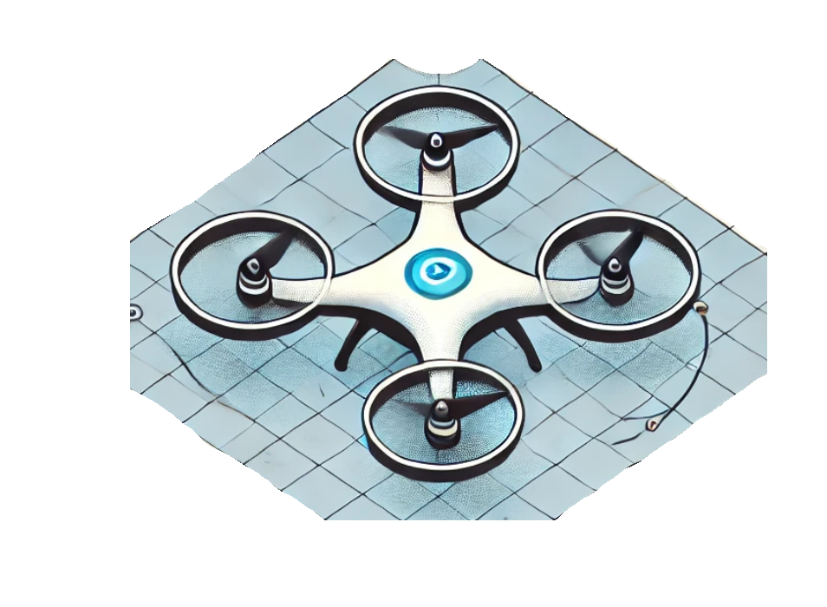
Q-Learning for Intelligent Drone Decisions
Model Structure:
State Space: Drone’s position, obstacles, network status, battery level, in congestion, nearest congestion.
Action Space: Movement in eight directions; accelerate/decelerate.
Reward Structure:
Positive Rewards: Delivery, reaching Depot, Emergency Landing Spot
Negative Rewards: Battery depletion, congestion entry, collisions.
Reward
Next
State
Action
State

Slide 5
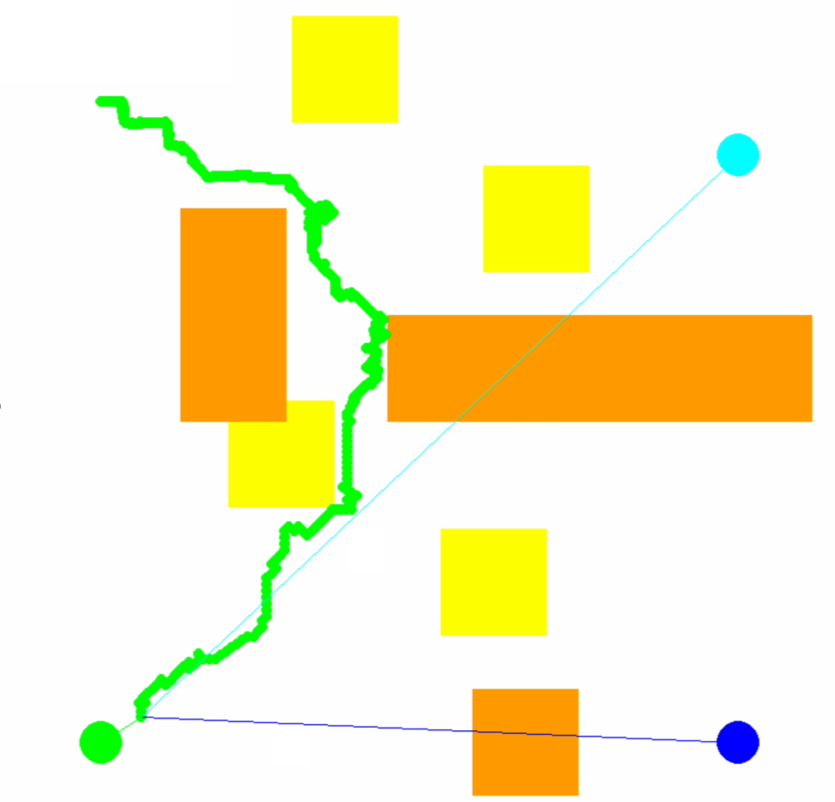
Testing in Simulations
Assumptions
Single Drone
Simulation Environment:
Grid Setup: 800x800 pixel environment
Grid Elements: Start/end positions, emergency landing spots, depot, dynamic congestion zones.
Simulation Parameters:
Episodes: 100,000 for training.
Depot
Obstacle
800 px
Cong.
Zone
Emergency Landing Spot
Customer
800 px

Slide 6
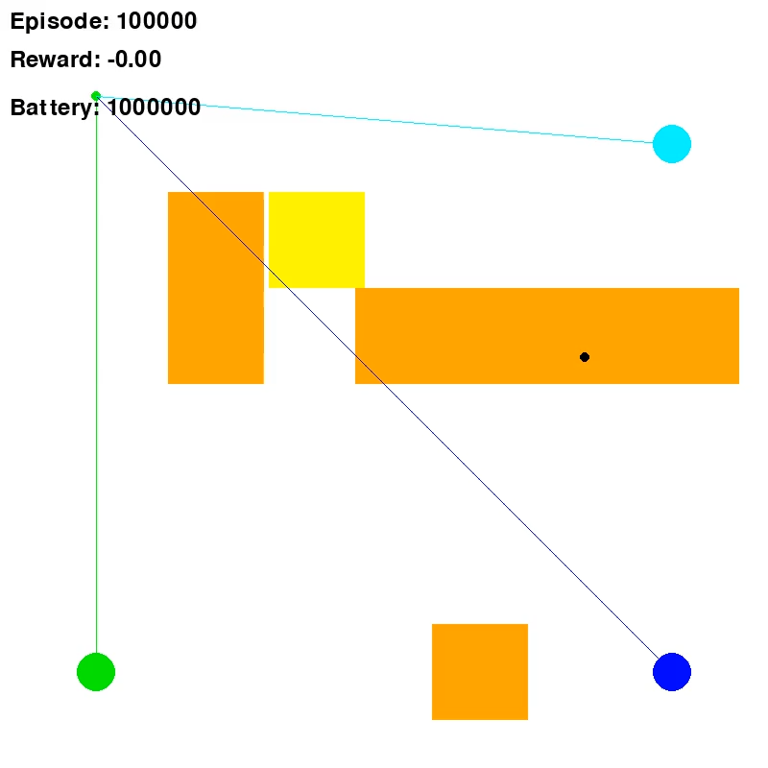
Scenario Analysis
Scenario 1: After delivery, drone decides to land at an emergency site.

Slide 7
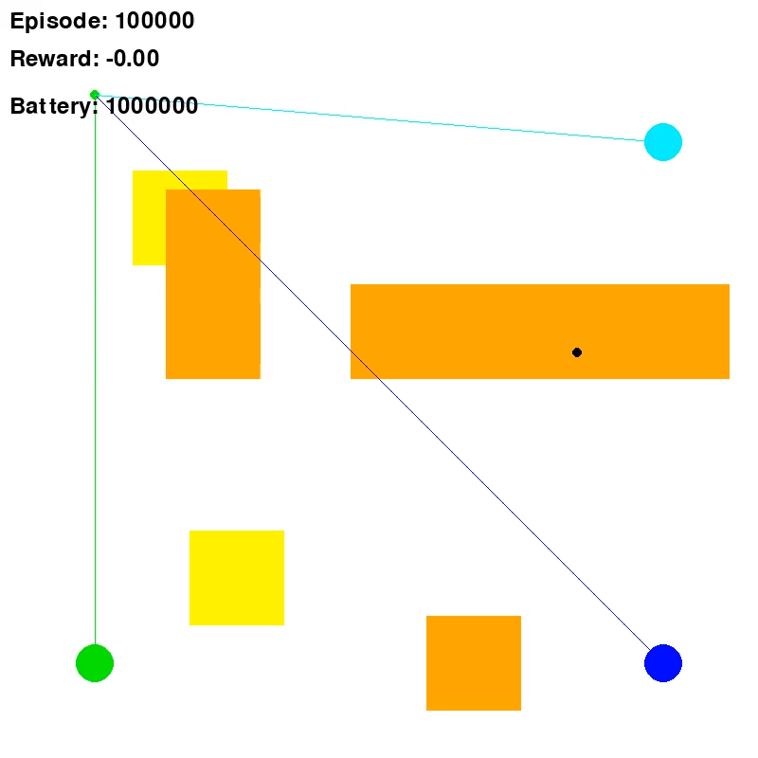
Scenario Analysis
Scenario 2: Drone returns to depot if delivery becomes too risky

Slide 8
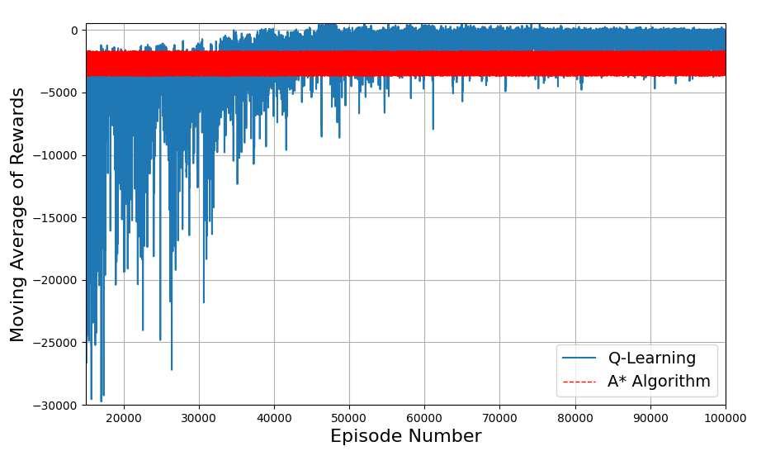
Results
Performance Analysis:
Reward Comparison: Q-learning shows 23% higher reward accumulation than A*. (A* algorithm goes for the customer and then to the emergency landing spot always)

Slide 9
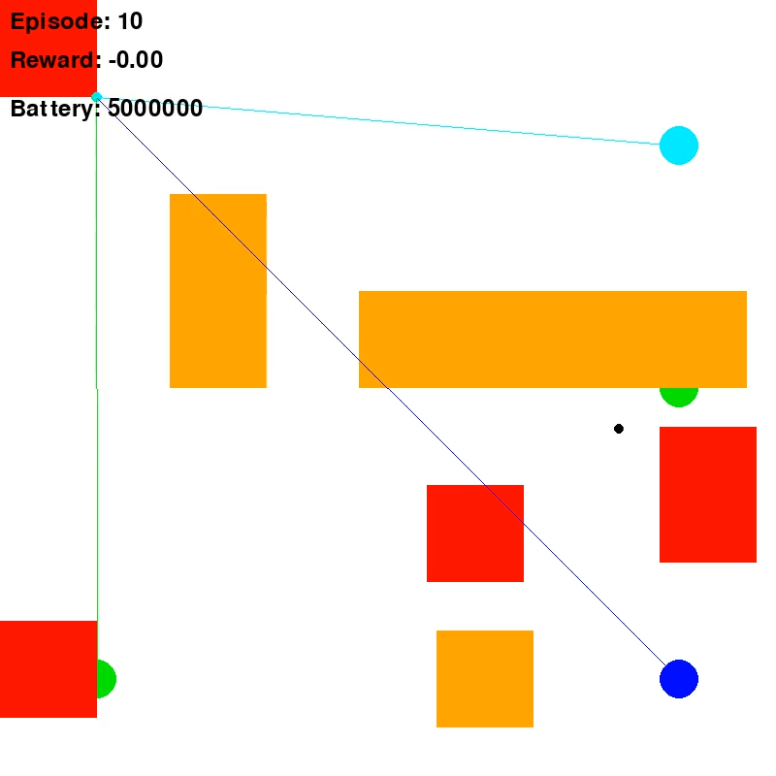
Improvements since paper
Introduction of multi drone system with multiple customers

Slide 10
Discussion
Key Insights:
Safety: Prioritizes safe recovery and avoids high-risk situations
Energy Efficiency: Balances successful deliveries with energy conservation for longer missions.
Flexibility: Enables real-time adaptation without continuous supervision.
Limitations:
Higher computational load with expanding environment complexity.
Future Work:
Advanced RL algorithms like DQN, PPO
Real-world testing to validate model.

